Slide 1
Algoritmi Paraleli și Distribuiți Algoritmi peer-to-peer
Prof. Ciprian Dobre
ciprian.dobre@cs.pub.ro

Slide 2

Peer-to-peer (P2P)

Slide 3
Ce este un sistem Peer-to-Peer (P2P)?
O arhitectura de sistem distribuit in care:
Nu exista un control centralizat
Nodurile sunt aproape simetrice in functionalitate
Numar mare de noduri unreliable
Capacitate mare de deservire a serviciilor, prin paralismul adus de:
Multe discuri
Multe legaturi de retea
Multe CPI-uri
Absenta unui server centralizat inseamna:
Mai putine sanse de overload
Deployment mai usor
Un defect nu poate strica intregul sistem
Sistemul per ansamblu e mai greu de atacat
Node
Node
Node
Internet
Node
Node

Slide 4
Peer-to-peer (P2P)
Descentralizare!
Greu de coordonat cand nodurile intra si parasesc dinamic

Slide 5



Peer-to-peer (P2P)
Napster (1999)

Slide 6
Peer-to-peer (P2P)
Napster (1999)

Slide 7
Peer-to-peer (P2P)
Napster (1999)
Problema – server centralizat pentru indexarea datelor

Slide 9



Peer-to-peer (P2P)
Napster (1999)
Problema – server centralizat pentru indexarea datelor
Solutia - Distributed hash table

Slide 10
Distributed Hash Tables (DHT)
Hash table
k₀
v₀
k₁
v₁
k₂
v₂
k₃
v₃
k₄
v₄
k₅
v₅

Slide 11
Distributed Hash Tables (DHT)
Hash table
k₀
v₀
k₁
v₁
k₀
v₀
k₂
v₂
k₁
v₁
k₃
v₃
k₄
v₄
k₄
v₄
k₅
v₅
k₅
v₅
k₂
v₂
k₃
v₃

Slide 12
Distributed Hash Tables (DHT)
Proprietati dorite:
Descentralizare
Load-balancing
Scalabilitate
Disponibilitate
k₀
v₀
k₁
v₁
k₄
v₄
k₅
v₅
k₂
v₂
k₃
v₃

Slide 13
Distributed Hash Tables
Distributed Hash Table:
key = hash(data)
lookup(key) → IP addr (Chord lookup service)
send-RPC(IP address, put, key, data)
send-RPC(IP address, get, key) → data
Partitionam datele peste sisteme distribuite pe scara larga
Punem tupluri intr-un global database engine
si blocurile de date intr-un sistem global de fisiere
peste un P2P file-sharing system
*RPC = Remote Procedure Call

Slide 14
BitTorrent peste DHT
BitTorrent poate folosi DHT in loc de (sau in conjuctie cu un) tracker
Clientii BT folosesc DHT:
Key = file content hash (“infohash”)
Value = Adresa IP a peer-ului ce poate servi fisierul
Poate stoca mai multe valori (i.e. IP addresses) pentru o cheie
Clientul apeleaza:
get(infohash) pentru a gasi alti clienti ce pot servi fisierul
put(infohash, my-ipaddr) pentru a se identifica ca detinator al fisierului

Slide 15
Chord: un DHT performant

Slide 16
Stoica, I., Morris, R., Karger, D., Kaashoek, M. F., & Balakrishnan, H. (2001). Chord: A scalable peer-to-peer lookup service for internet applications. ACM SIGCOMM Computer Communication Review, 31(4), 149-160.

Slide 17
Algoritmul Chord pentru lookup
Interfata: lookup(key) → IP address
Eficient: O(log N) mesaje pentru operatia de lookup
N fiind numarul total de servere
Scalable: O(log N) stari per nod
Robust: poate supravietui unui numar mare de noduri defecte

Slide 18
Chord – DHT eficient
Cum asignam chei nodurilor peer?
Hash table
k₀
v₀
k₁
v₁
k₀
v₀
k₂
v₂
k₁
v₁
k₃
v₃
k₄
v₄
k₄
v₄
k₅
v₅
k₅
v₅
k₂
v₂
k₃
v₃

Slide 19
Chord
Hash table
k₀
v₀
k₁
v₁
k₂
v₂
k₃
v₃
k₄
v₄
k₅
v₅

Slide 20
Chord
k₅
k₄
Hash table
k₀
v₀
k₁
v₁
k₀
k₂
v₂
k₃
v₃
k₁
k₄
v₄
k₃
k₅
v₅
k₂

Slide 21
Chord
k₅
k₀
v₀
k₄
k₁
v₁
Hash table
k₄
v₄
k₅
v₅
k₀
v₀
k₁
v₁
k₀
k₂
v₂
k₃
v₃
k₁
k₄
v₄
k₃
k₅
v₅
k₂
v₂
k₃
v₃
k₂

Slide 22
Identificatori Chord
Key identifier = SHA-1(key)
Node identifier = SHA-1(IP address)
SHA-1 asigura o distributie uniforma a ambelor
Cum partitioneaza Chord datele?
i.e., map key IDs to node IDs

Slide 23
Chord (distributia cheilor)
Inel de identificatori peste spatiul hash 2^{m}
2^{m}-1
0
1
2^{m-1}

Slide 24
Chord (distributia cheilor)
Inel de identificatori peste spatiul hash 2^{m}
2^{m}-1
0
1
= node
= key
node id = hash( node )
key id = hash( key )
2^{m-1}

Slide 25
Consistent hashing [Karger ‘97]
Key 5
K5
N105
K20
Node 105
Circular 7-bit
ID space
N32
N90
K80
Cheia este stocata la successor: nodul avand urmatorul cel mai mare ID

Slide 26
Chord: Successor pointers
N120
N10
N105
N32
K80
N90
N60

Slide 27
Basic lookup
N120
N10
“Where is K80?”
N105
“N90 has K80”
N32
K80
N90
N60

Slide 28
Simple lookup algorithm
Lookup(key-id)
succ ← my successor
if my-id < succ < key-id // next hop
call Lookup(key-id) on succ
else // done
return succ
Corectitudinea depinde doar de succesori

Slide 29
Imbunatatirea performantei
Problema: Forwardarea prin intermediul succesorului poate fi inceata
Stuctura de date este o lista inlantuita: O(n)
Idee: Putem sa facem operatia sa arate mai mult a binary search?
Adica sa imbunatatim distanta cu fiecare pas

Slide 30
“Finger table” permite operatii de lookup in timp log N
¼
½
1/8
1/16
1/32
1/64
N80

Slide 31
Finger i redirecteaza catre succesorul lui n+2^{i}
N120
K112
¼
½
1/8
1/16
1/32
1/64
N80

Slide 32
Implicatii ale tabelei finger
Avem un binary lookup tree cu fiecare nod
Cu ramuri redirectate catre alte tabele finger ale celorlalte noduri
Este mai bine decat sa aranjam nodurile intr-un singur arbore
Fiecare nod actioneaza ca radacina a unui arbore
Deci nu exista niciun root hotspot
Nu exista single point of failure

Slide 33
Lookup with finger table
Lookup(key-id)
look in local finger table for
highest n: my-id < n < key-id
if n exists
call Lookup(key-id) on node n // next hop
else
return my successor // done

Slide 34
Chord
Inel de identificatori peste spatiul hash 2^{m}
2^{m}-1
0
1
= node
= key
node id = hash( node )
key id = hash( key )
successor(id)
finger table for node at id i
finger
node id
1
succ(i)
2
succ(i + 2)
2^{m-1}
j
succ(i + 2 ^{j - 1} )

Slide 35
Chord
Inelul de identificatori
0
= node
= key
12
4
8

Slide 36
Chord
Inel de identificatori
0
= node
= key
12
4
8

Slide 37
Chord
Inel de identificatori
0
= node
= key
12
4
finger
node id
1
succ(i)
2
succ(i + 2)
3
succ(i + 2²)
4
succ(i + 2³)
8

Slide 38
Chord
Inel de identificatori
0
= node
= key
12
4
finger
node id
1
succ(4)
2
succ(4 + 2)
3
succ(4 + 2²)
4
succ(4 + 2³)
8

Slide 39
Chord
Inel de identificatori
0
= node
= key
12
4
finger
node id
1
5
2
8
3
8
4
1
8

Slide 40
Asadar... Chord Lookup
find_successor(id):
p = find_predecessor(id)
return p.successor
find_predecessor(id):
n = self
while id not between (n, n.successor]:
n = n.closest_preceding_finger(id)
return n
0
12
4
finger
node id
1
5
2
8
3
8
4
1
finger
node id
1
11
8
2
11
3
1
4
1

Slide 41
Chord - Lookup
find_successor(id):
p = find_predecessor(id)
return p.successor
find_predecessor(id):
n = self
while id not between (n, n.successor]:
n = n.closest_preceding_finger(id)
return n
Inel de identificatori
0
12
4
lookup(10)
finger
node id
1
5
2
8
3
8
finger
node id
4
1
1
11
8
2
11
3
1
4
1

Slide 42
Chord - Lookup
find_successor(id):
p = find_predecessor(id)
return p.successor
find_predecessor(id):
n = self
while id not between (n, n.successor]:
n = n.closest_preceding_finger(id)
return n
0
finger
node id
1
5
2
8
12
4
3
8
4
1
lookup(10)
follow finger 3 to node id 8
finger
node id
1
11
8
2
11
3
1
4
1

Slide 43
Chord - Lookup
find_successor(id):
p = find_predecessor(id)
return p.successor
find_predecessor(id):
n = self
while id not between (n, n.successor]:
n = n.closest_preceding_finger(id)
return n
0
finger
node id
1
5
2
8
12
4
3
8
4
1
lookup(10)
follow finger 3 to node id 8
node id 8 identifies as predecessor of id 10
finger
node id
1
11
8
2
11
3
1
4
1

Slide 44
Chord - Lookup
find_successor(id):
p = find_predecessor(id)
return p.successor
find_predecessor(id):
n = self
while id not between (n, n.successor]:
n = n.closest_preceding_finger(id)
return n
0
finger
node id
1
5
2
8
12
4
3
8
4
1
lookup(10)
follow finger 3 to node id 8
node id 8 identifies as predecessor of id 10
complete lookup at successor of node id 8
finger
node id
1
11
8
2
11
3
1
4
1

Slide 45
Chord - Lookup
find_successor(id):
p = find_predecessor(id)
return p.successor
find_predecessor(id):
n = self
while id not between (n, n.successor]:
n = n.closest_preceding_finger(id)
return n
0
finger
node id
Nr. de hopuri?
Fiecare op. finger lookup injumatateste distanta la cheie =>
O(log N)
1
5
2
8
12
4
3
8
4
1
lookup(10)
follow finger 3 to node id 8
node id 8 identifies as predecessor of id 10
complete lookup at successor of node id 8
finger
node id
1
11
8
2
11
3
1
4
1

Slide 46
Joining: Linked list insert
N25
N36
1. Lookup(36)
N40
K30
K38

Slide 47
Join (2)
N25
2. N36 sets its own
successor pointer
N36
N40
K30
K38

Slide 48
Join (3)
N25
3. Copy keys 26..36
from N40 to N36
N36
K30
N40
K30
K38

Slide 49
Mesajele notify mentin predecesorii
N25
notify N25
N36
N40
notify N36

Slide 50
Mesajele stabilize fixeaza succesorii
N25
✔
✘
stabilize
N36
N40
“My predecessor is N36.”

Slide 51
Failures may cause incorrect lookup
N120
N113
N10
N102
N85
Lookup(K90)
N80
N80 does not know correct successor, so incorrect lookup

Slide 52
Exemplu: Chord - Joins + Stabilization
join():
self.predecessor = null
self.successor = find_successor(self)
stabilize():
p = self.successor.predecessor
if p between (self, self.successor):
self.successor = p
self.successor.notify(self)
notify(n):
if self.predecessor == null ||
n between (self.predecessor, self):
self.predecessor = n
0
12
4
8

Slide 53
Chord - Joins + Stabilization
join():
self.predecessor = null
self.successor = find_successor(self)
stabilize():
p = self.successor.predecessor
if p between (self, self.successor):
self.successor = p
self.successor.notify(self)
notify(n):
if self.predecessor == null ||
n between (self.predecessor, self):
self.predecessor = n
0
12
4
predecessor = 4
successor = 8
predecessor = 5
successor = 11
8

Slide 54
Chord - Joins + Stabilization
join():
self.predecessor = null
self.successor = find_successor(self)
stabilize():
p = self.successor.predecessor
if p between (self, self.successor):
self.successor = p
self.successor.notify(self)
notify(n):
if self.predecessor == null ||
n between (self.predecessor, self):
self.predecessor = n
0
12
4
predecessor = 4
successor = 8
join(), self = 6
predecessor = 5
successor = 11
8
predecessor = null
successor = 8

Slide 55
Chord - Joins + Stabilization
join():
self.predecessor = null
self.successor = find_successor(self)
stabilize():
p = self.successor.predecessor
if p between (self, self.successor):
self.successor = p
self.successor.notify(self)
notify(n):
if self.predecessor == null ||
n between (self.predecessor, self):
self.predecessor = n
0
12
4
predecessor = 4
successor = 8
stabilize()
predecessor = 5 6
successor = 11
8
predecessor = null
successor = 8

Slide 56
Chord - Joins + Stabilization
join():
self.predecessor = null
self.successor = find_successor(self)
stabilize():
p = self.successor.predecessor
if p between (self, self.successor):
self.successor = p
self.successor.notify(self)
notify(n):
if self.predecessor == null ||
n between (self.predecessor, self):
self.predecessor = n
0
12
4
predecessor = 4
successor = 8 6
stabilize()
predecessor = 5 6
successor = 11
8
predecessor = null 5
successor = 8

Slide 57
Chord - Joins + Stabilization
join():
self.predecessor = null
self.successor = find_successor(self)
stabilize():
p = self.successor.predecessor
if p between (self, self.successor):
self.successor = p
self.successor.notify(self)
notify(n):
if self.predecessor == null ||
n between (self.predecessor, self):
self.predecessor = n
0
12
4
predecessor = 4
successor = 6
predecessor = 5
successor = 8
predecessor = 6
successor = 11
8

Slide 58
Chord - Failure + Replication
0
E mentinuta o lista a k succesori
Cheile sunt replicate pe toti k succesorii
12
4
predecessor = [4, 1]
successor = [6, 8]
predecessor = [5, 4]
successor = [8, 11]
predecessor = [6, 5]
successor = [11, 1]
8

Slide 59
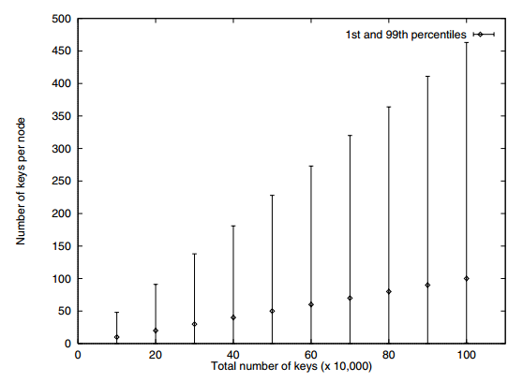
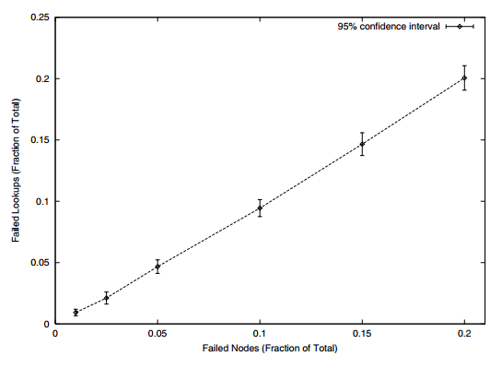
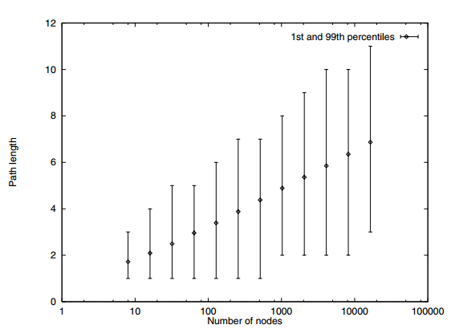
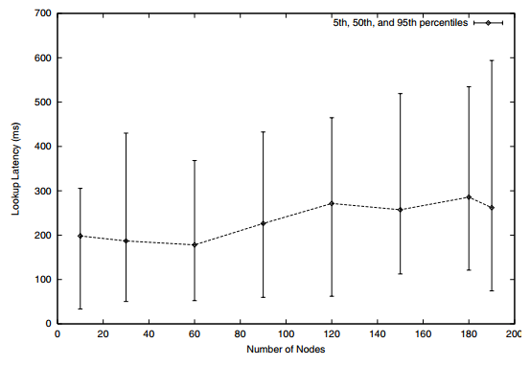
Load balance
Failure resilience
Lookup path length
Lookup latency

Slide 60
Load balance
Failure resilience
Lookup path length
Lookup latency

Slide 61
Load balance
Failure resilience
Lookup path length
Lookup latency

Slide 62
Gummadi, K., Gummadi, R., Gribble, S., Ratnasamy, S., Shenker, S., & Stoica, I. (2003, August). The impact of DHT routing geometry on resilience and proximity. In Proceedings of the 2003 conference on Applications, technologies, architectures, and protocols for computer communications (pp. 381-394). ACM.

Slide 63
Topologii de rutare in spatele unor DHT
Ring (Chord)
Tree (Tapestry, PRR)
Hypercube (CAN)
Butterfly (Viceroy)
XOR (Kademlia)
Hybrid (Pastry, Bamboo)

Slide 64
Proximity + Resilience
Flexibility
Proximity – Alegerea unor rute prin vecini “geografic apropiati” reduce latenta
Resilience – Continuarea rutarii unor cereri chiar cand apar partitionari si defecte la nivelul retelei
Neighbor selection – optiunea de a selecta ce noduri peer sa pastram in tabela de rutare
Route selection – optiunea de a selecta unde sa rutam o anumita destinatie
Flexibility in neighbor selection -> good proximity
Flexibility in route selection -> good resilience

Slide 65
Topologii de rutare in spatele unor DHT
Ring (Chord)
Tree (Tapestry, PRR)
Hypercube (CAN)
Butterfly (Viceroy)
XOR (Kademlia)
Hybrid (Pastry, Bamboo)

Slide 66
Topologii de rutare in spatele unor DHT - Arbore
XXX
0XX
00X
000
001
010
011
100
101
110
111

Slide 67
Topologii de rutare in spatele unor DHT - Arbore
Neighbor selection – un nod pentru fiecare prefix din subarborele opus
XXX
0XX
00X
000
001
010
011
100
101
110
111

Slide 68
Topologii de rutare in spatele unor DHT - Arbore
Neighbor selection – un nod pentru fiecare prefix din subarborele opus
XXX
Route selection – rutarea catre vecinul din subarborele destinatiei
0XX
00X
Good flexibility in neighbor selection
Poor flexibility in route selection
000
001
010
011
100
101
110
111

Slide 69
Topologii de rutare in spatele unor DHT - Hipercub
Neighbor selection – vecinii difera printr-un bit in descompunerea binara
110
111
100
101
011
010
000
001

Slide 70
Topologii de rutare in spatele unor DHT - Hipercub
Neighbor selection – vecinii difera printr-un bit in descompunerea binara
110
111
100
101
Route selection – rutare catre destinatie prin corectarea oricarui bit diferit
011
010
000
001
Poor flexibility in neighbor selection
Good flexibility in route selection

Slide 71
Topologii de rutare in spatele unor DHT - Inel
Neighbor selection – un vecin in fiecare interval de finger
000
111
001
110
010
101
011
100

Slide 72
Topologii de rutare in spatele unor DHT - Inel
Neighbor selection – un vecin in fiecare interval de finger
000
111
001
Route selection – rutarea catre destinatie prin progresarea de-a lungul inelului
110
010
Good flexibility in neighbor selection
Good flexibility in route selection
101
011
100

Slide 73
BitTorrent
Principalul exemplu de sistem P2P in folosinta astazi (alaturi de Boinc):
Dezvoltat de Cohen in ‘01
Mare parte din traficul de Internet astazi!
Folosit pentru transfer de continut legal si mai putin legal (aici intervine rolul DHT)
Date livrate folosind “torrents”:
Fisierele sunt transferate in bucati, e favorizat paralelismul
Foloseste un tracker sau un decentralized index (DHT)
Bram Cohen (1975 -)

Slide 74
Exemplu: BitTorrent
User clicks on download link
Gets torrent file with content hash, IP addr of tracker
User’s BitTorrent (BT) client talks to tracker
Tracker tells it list of peers who have file
User’s BT client downloads file from one or more peers
User’s BT client tells tracker it has a copy now, too
User’s BT client serves the file to others for a while
Provides huge download bandwidth, without expensive server or network links

Slide 75
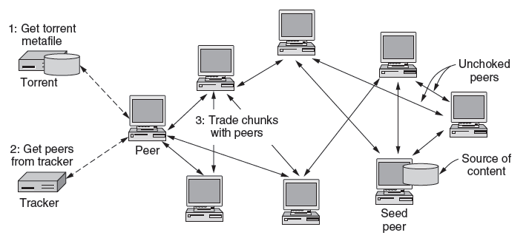
BitTorrent Protocol (2)
Toti peers (cu exceptia celor seed) regasesc torrenti in acelasi timp

Slide 76
BitTorrent Protocol (3)
Fisierele sunt impartite in bucati, ceea ce permite descarcarea paralela (viteza de download)

Slide 77
BitTorrent Protocol (5)
Indexul DHT (distribuit intre peers) este complet descentralizat
DHT
DHT
DHT
DHT
DHT
DHT
DHT
DHT

Slide 78
Cooperative storage with a DHT
Distributed application
put(key, data)
get (key)
data
Distributed hash table
(DHash)
lookup(key)
node IP address
Lookup service
(Chord)
node
node
….
node
Aplicatiile pot fi distribuite pe multe noduri
DHT distribuie stocarea de date pe mai multe noduri

Slide 79
BitTorrent si DHT
BitTorrent poate folosi DHT in loc de (sau lucreaza impreuna cu un) tracker
Clientii BT folosesc DHT:
Key = file content hash (“infohash”)
Value = IP address of peer willing to serve file
Clientul:
get(infohash) pentru a gasi alti client ce pot deserve o descarcare
put(infohash, my-ipaddr) pentru a se identifica ca furnizor de content

Slide 80
La ce foloseste un DHT pentru BitTorrent?
DHT e un tracker in sine, mai putin fragmentat decat alti tracker
Nodurile peer se pot regasi unele cu altele mai usor, chiar si in prezenta defectelor
In plus, un tracker classic este expus unor probleme de legalitate

Slide 81
Sumar
Sisteme peer-to-peer
Distributed Hash Tables
Chord
Topologii din spatele DHT
Exemplificare BitTorrent

